Slide 1

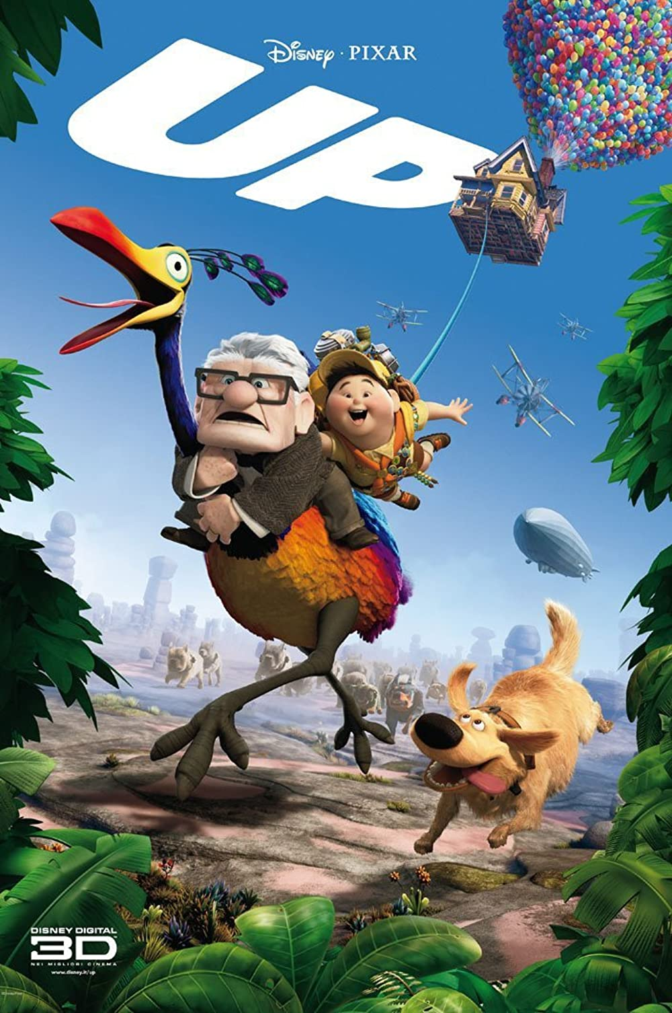
MOVIE REVENUE
PREDICTION
Chetana Vyas
Notes:
Let’s see how we can predict movie revenue

Slide 2
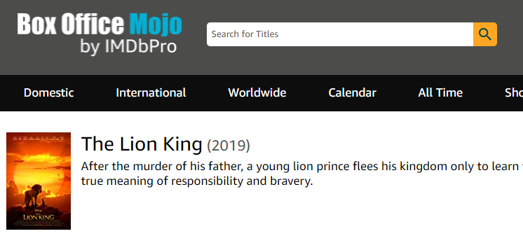
Modelling Framework
Original data: 6360 data points + 11 features
Final data: 2199 data points + 46 features
Box Office Mojo Website: https://www.boxofficemojo.com/
Notes:
Dealt with duplicate movie information and rows having missing values for budget, genres
Initial Data Acquisition, Data Cleaning, Feature Engineering

Slide 3

REGRESSION ALGORITHMS
Budget $$$
MPAA Rating
[G, PG, PG-13, R,..]
PREDICTED
REVENUE $$$
Running Time
Release Month
(Seasonality changes)
 | Final Model
R² | 0.47
RMSE | $ 62 MIL
Genres
(Animation, Comedy, Romance,...)
Rank, Domestic Opening, IMDB Rating ?
Notes:
Let’s not get into the technicality of the terms R^2 and RMSE (Root Mean Squared Errors).
Important thing to understand is, we have done modelling multiple times to understand which features have significant impact on the target, the features having direct correlation to the target revenue i.e. rank or opening budget and accordingly removed.

Slide 4
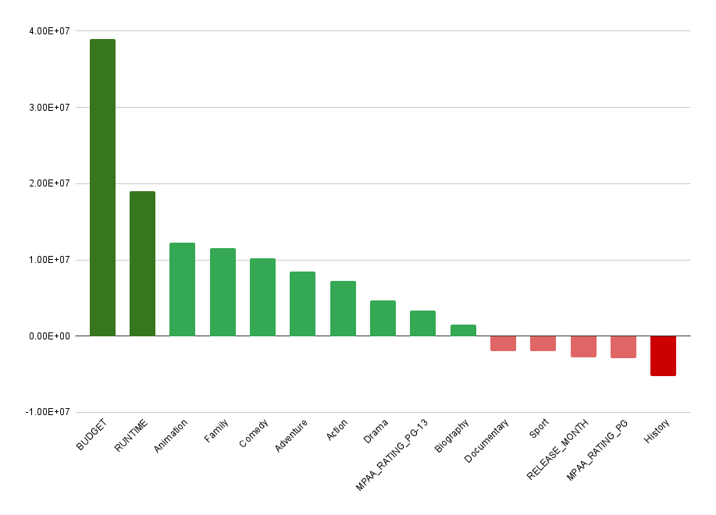
Recommendations
High Budget Movie $$$
Summer or Holiday
(Thanksgiving / Christmas)
Blockbuster release
Genres
(Animation, Comedy, Action)
MPAA Rating PG-13
Notes:
After multiple iterations and tuning the parameters and regression modelling, let’s have a look at the pre-release features that have a significant impact on the movie revenue.

Slide 5
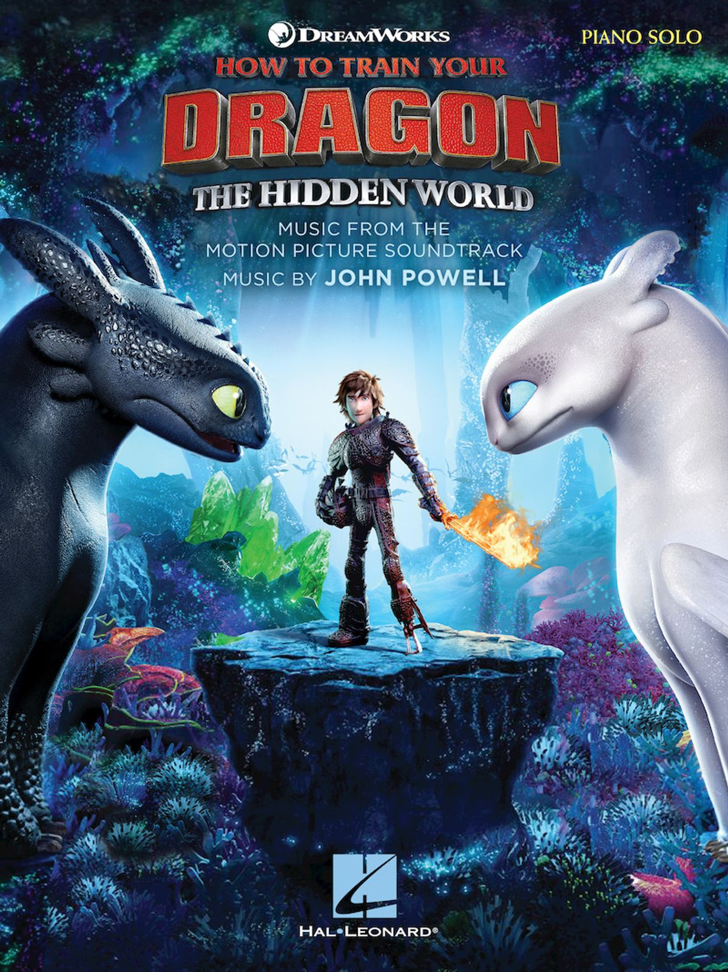
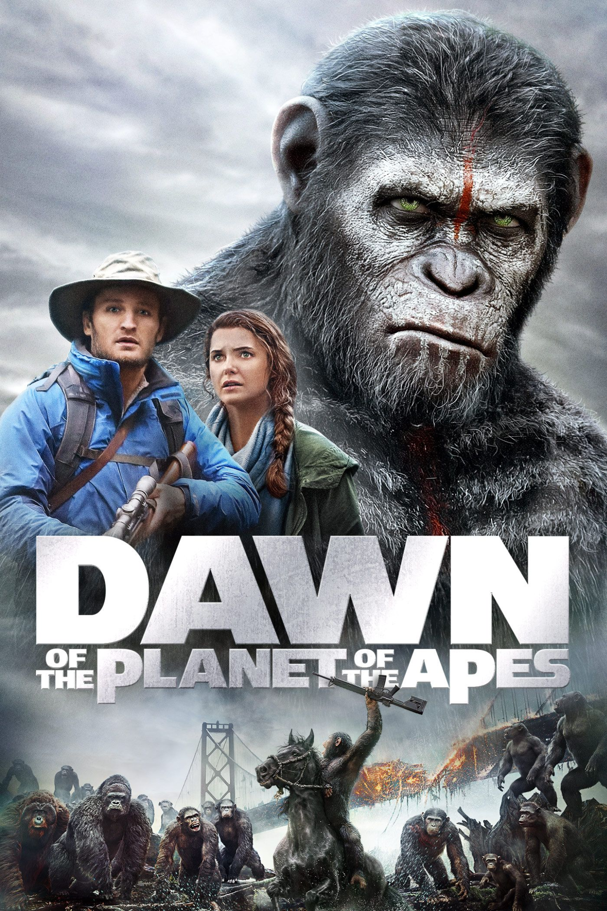
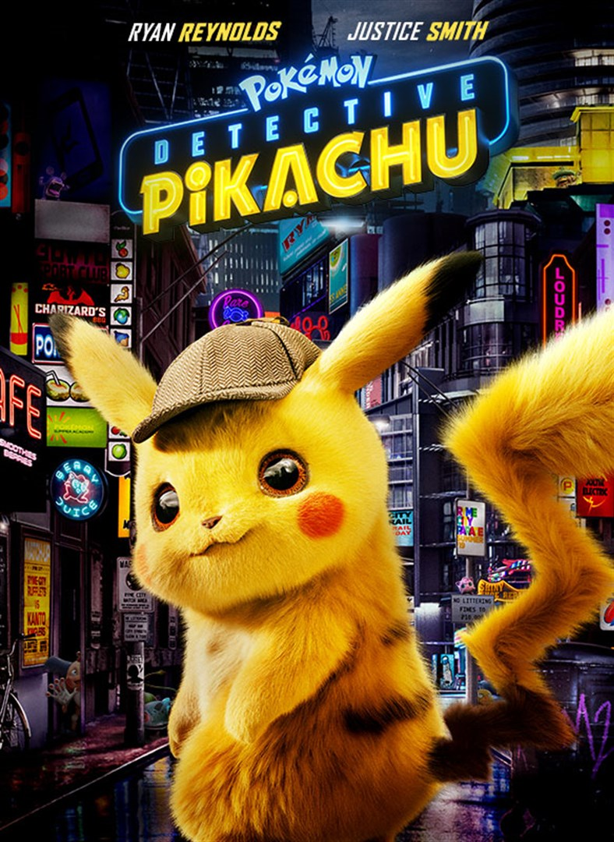

MODEL PREDICTICTIONS
ACTUAL | $ 161 M | $ 209 M | $ 144 M | $ 199 M
PREDICTED | $ 153 M | $ 196 M | $ 146 M | $ 177 M
DIFF | $ 8 M (5%) | $ 13 M (6%) | $ 13 M (8%) | $ 22 M (11%)
Notes:
Looks like our model does a spectacular job at predicting the movie revenues! Prediction is off by ~ 10%

Slide 6
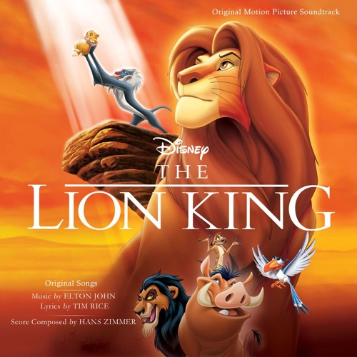

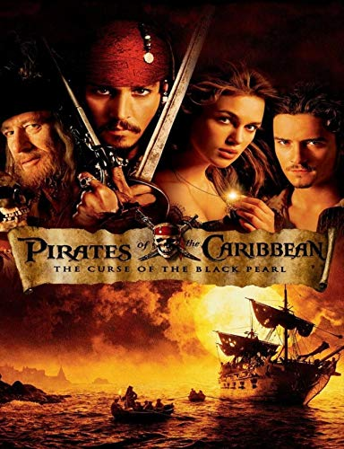
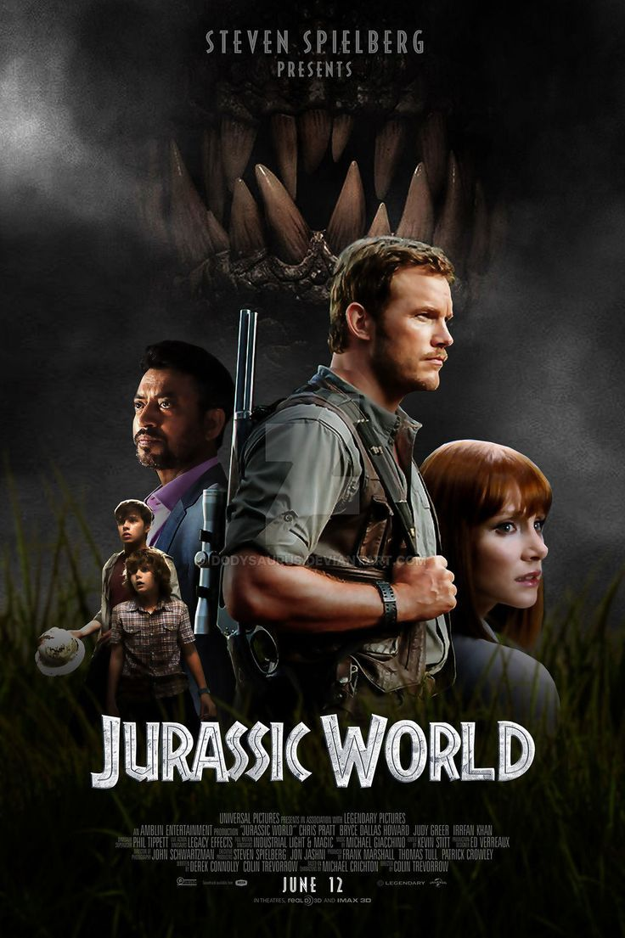
WHAT HAPPENED HERE?
ACTUAL | $ 544 M | $ 243 M | $ 305 M | $ 652 M
PREDICTED | $ 313 M | $ 110 M | $ 189 M | $ 185 M
DIFF | $ 231 M (42%) | $ 133 M (54%) | $ 116 M (38%) | $ 468 M (72%)
Notes:
What the hell happened here?!?!
The Lion King: 1994 - It was one of its kind back then, hard to predict (July 11)
Harry Potter’s 1st movie of the series. Yet, our model failed to predict (November 16)
Jurassic World: MOVIE IS ACTUALLY THE REMAKE OF AN OLD MOVIE. We didn’t not take this scenario into consideration (June 10)
Pirates: (July 6) These factors are crucial when it comes to movie performance
Some of the movies here (Lion King and Harry Potter) are examples of outliers that our model fails to predict. Remaining movies tell us

Slide 7


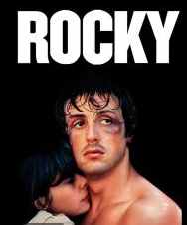
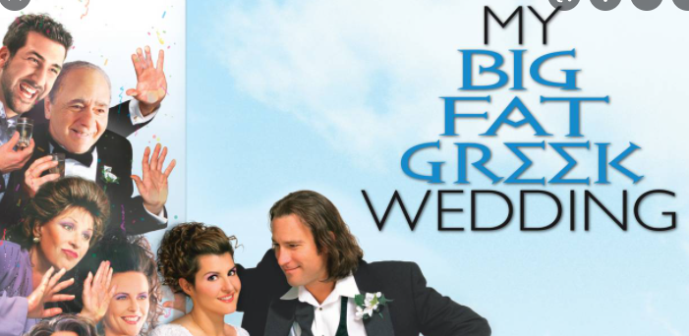
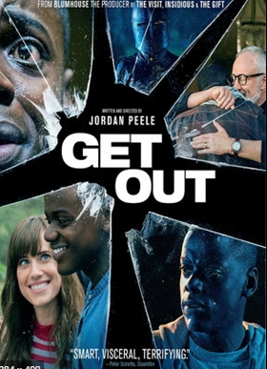
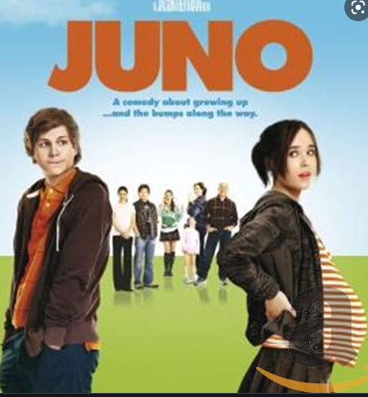
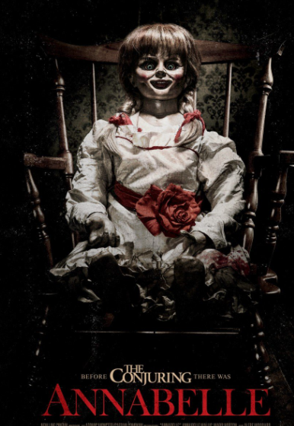
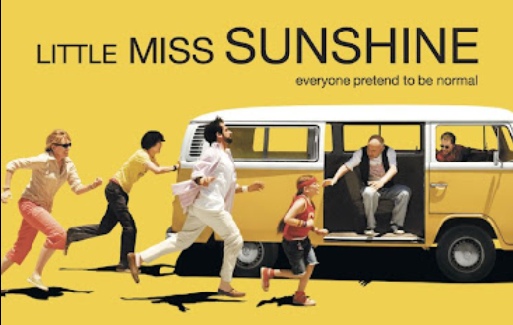
Can we build the perfect model (say R² = 1) if we had all possible pre release movie features?
Notes:
We will always have super high budget movies that are box office bombs
Low Budget Films that became Blockbuster hits!
marketing budget, actors, directors - entire cast, storyline, sequel / prequel, based on book, covid cases + vaccination rate?
The answer is still NO!
A huge part of this revenue prediction involves predicting human behaviour, and that is a hard problem to solve. Researchers cannot make predictions about human behavior

Slide 8

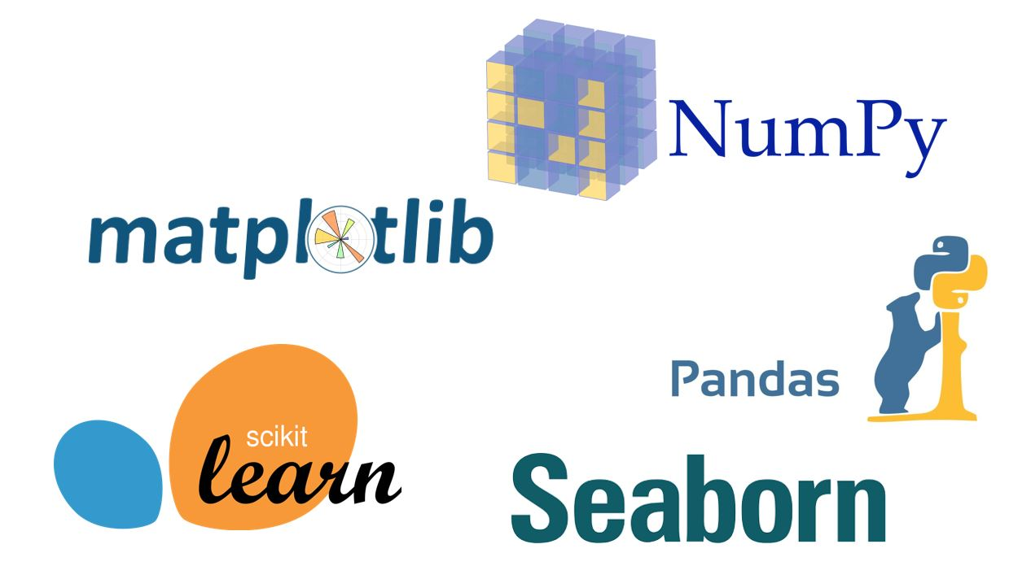

APPENDIX - TOOLS
Metis_Live Online
Notes:
For the sake of completeness, these are the tools I have used for building my model

Slide 9
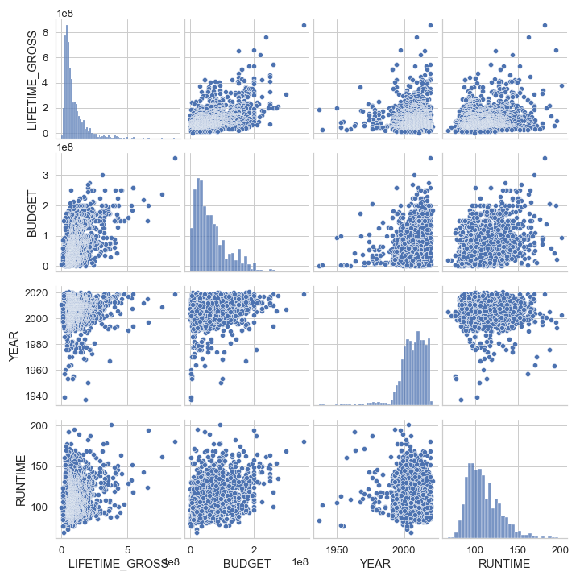
APPENDIX

Slide 10
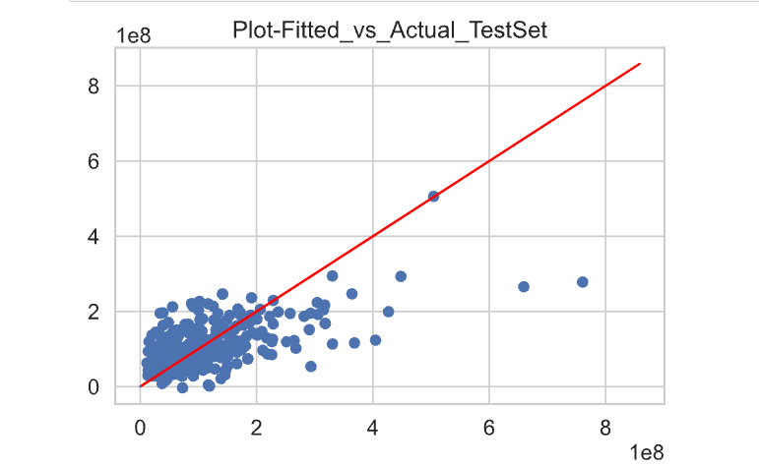
APPENDIX
Actual Revenue v/s Predicted Revenue on Testing DataSet

Slide 11
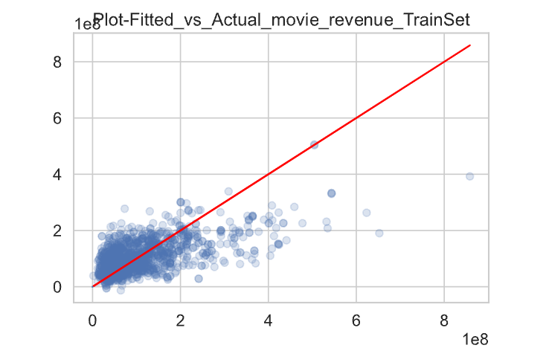
APPENDIX
Actual Revenue v/s Predicted Revenue on Training DataSet

Slide 12
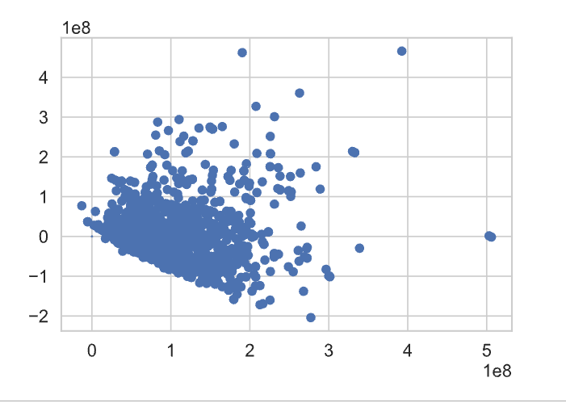
APPENDIX
Residual Analysis

Slide 13

Thank You !

